Slide 1




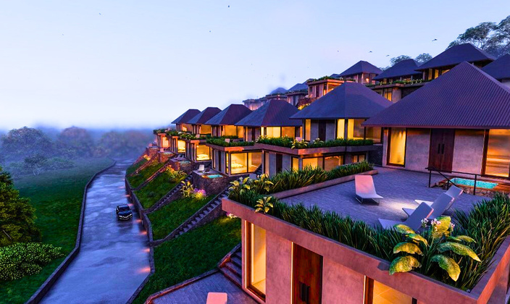
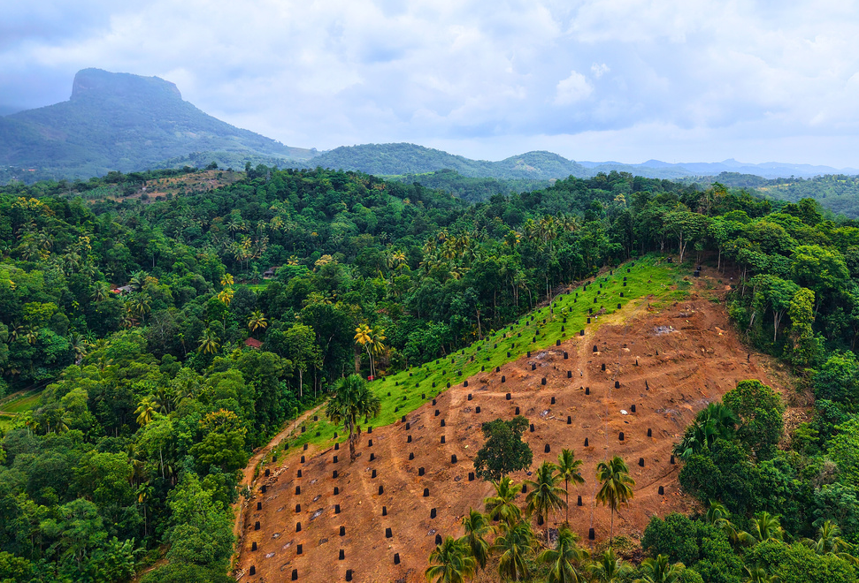


COMPANY PROFILE
Complete Solutions in Real Estate, Construction & Plantation.

Slide 2


About the Company
The Property Planners (Pvt) Ltd leads our real estate, construction, and consulting operations, ensuring reliable, high-quality outcomes.
TPP Plantation (Pvt) Ltd drives sustainable agriculture and plantation development.
Both operate under The Property Planners Co Pty Ltd (Australia), upholding strict governance, compliance, and ethical standards.
Together, we offer a 360° service platform uniting real estate, construction, and agriculture for sustainable growth.
Our Vision
To be the most trusted and innovative partner in real estate, construction, and plantation development delivering sustainable, high-quality solutions that create lasting value with integrity and innovation.
Our Mission
To simplify land and property development through end-to-end services built on transparency, technical excellence, and accountability consistently achieving results that align with client goals and foster long-term partnerships.

Slide 3

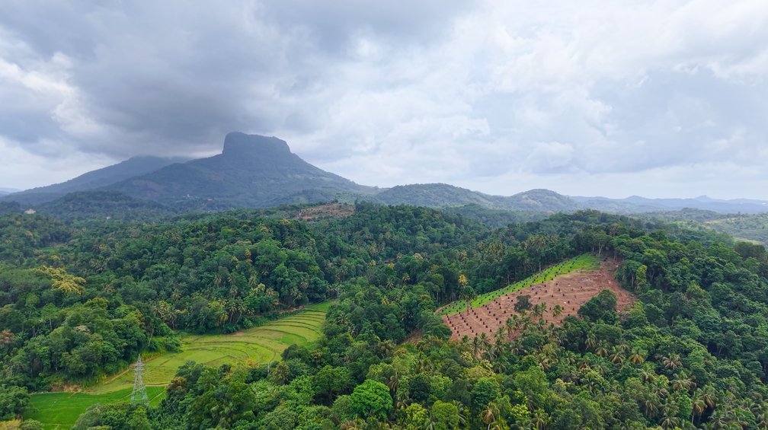

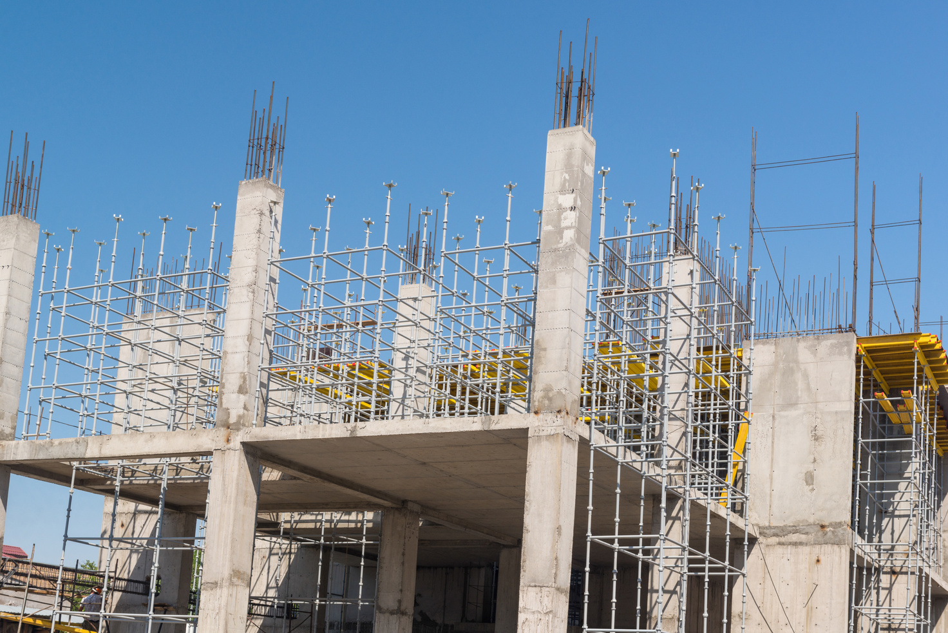


Welcome Message
It is our great pleasure to welcome you to The Property Planners Group. Founded with a vision to integrate real estate, construction, and sustainable agriculture under one trusted platform, we are committed to delivering solutions that combine global standards with local expertise.
With operations spanning Australia and Sri Lanka, our team is dedicated to transparency, innovation, and long-term value creation. We look forward to building partnerships that grow stronger with trust, quality, and shared success.

Slide 4



The Property Planners Co Pty Ltd
(Registered in Australia: ACN 680728170)
Corporate Structure
The Property Planners Group operates under a transparent corporate structure that ensures compliance, strategic focus, and efficiency across all units.
Governance Model
  Centralized policies for finance, compliance, and ethics
  Group Board aligns subsidiaries with corporate values and local laws
  Regional leadership empowered under parent-level governance
Leadership Oversight
Led by seasoned professionals in real estate, construction, agriculture, and related technologies, our teams are driven by integrity, innovation, and stakeholder value guided by The Property Planners Co Pty Ltd Board (Australia).
The Property Planners (Pvt) Ltd
(Registered in Sri Lanka: PV 00249791)
TPP Plantation (Pvt) Ltd
(Registered in Sri Lanka: PV 00321768)

Slide 5






Integrated Solutions
Real Estate
Construction & Development
Plantation & Agricultural
We assist buyers, sellers, and investors in navigating property markets with clarity, security, and strategy.
  Land sourcing and acquisition.
  Residential and commercial property sales.
  Buyer and seller representation.
  Legal verification and documentation support.
  Rental and property management solutions.
  Investment advisory and market analysis.
Our construction division delivers projects with a focus on structural quality, compliance, and timely execution.
  Turnkey residential and commercial construction
  Renovation and refurbishment
  Architectural design and 3D visualization
  Engineering and MEP coordination
  Project management and on-site supervision
  Permit handling and regulatory approvals
We deliver tailored solutions for sustainable land development and agro-investment from land preparation to international market access.
  Land preparation and plantation design
  Irrigation and resource management
  Crop planning and farm consulting
  Organic and sustainable farming systems
  Long-term productivity and soil health
  AI & Smart Farming and Agri-Technology.

Slide 6




Execution Focused
We deliver more than services we deliver confidence, trust, and long-term value. Guided by integrity, expertise, and respect for people and the environment, we offer a true partnership built for success.
  360° Integrated Solutions: Real estate, construction, and plantation under one brand, offering seamless end-to-end delivery.
  Legally Compliant & Structured: Backed by our Australian parent company, with full compliance across all Sri Lankan operations.
  Execution-Focused: Local expertise and strong governance ensure efficient, reliable, and high-quality delivery.
  Local Insight, Global Standards: Culturally respectful, legally aligned, and globally accountable.
  Sustainability & Smart Growth: Environmental responsibility and long-term value at the core of every project.

Slide 7

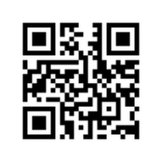



Contact Us
We welcome inquiries from clients, partners, and investors looking to explore opportunities in real estate, construction, or plantation development. Connect with us to discuss your project, request a proposal, or learn how we can deliver tailored, end-to-end solutions for your goals.
Sri Lanka Office
Australia Office
  No. 16, 1st Floor, Royal Plaza, Battaramulla, Sri Lanka
  +(94) 112 863 999 | +(94) 763 771 288
  info@tpp.lk | finance@tpp.lk | admin@tpp.lk
  www.tpp.lk
  Officer South, Victoria, Australia
  +61 491 247 288
  au@tpp.lk
  www.tpp.lk

